Slide 1
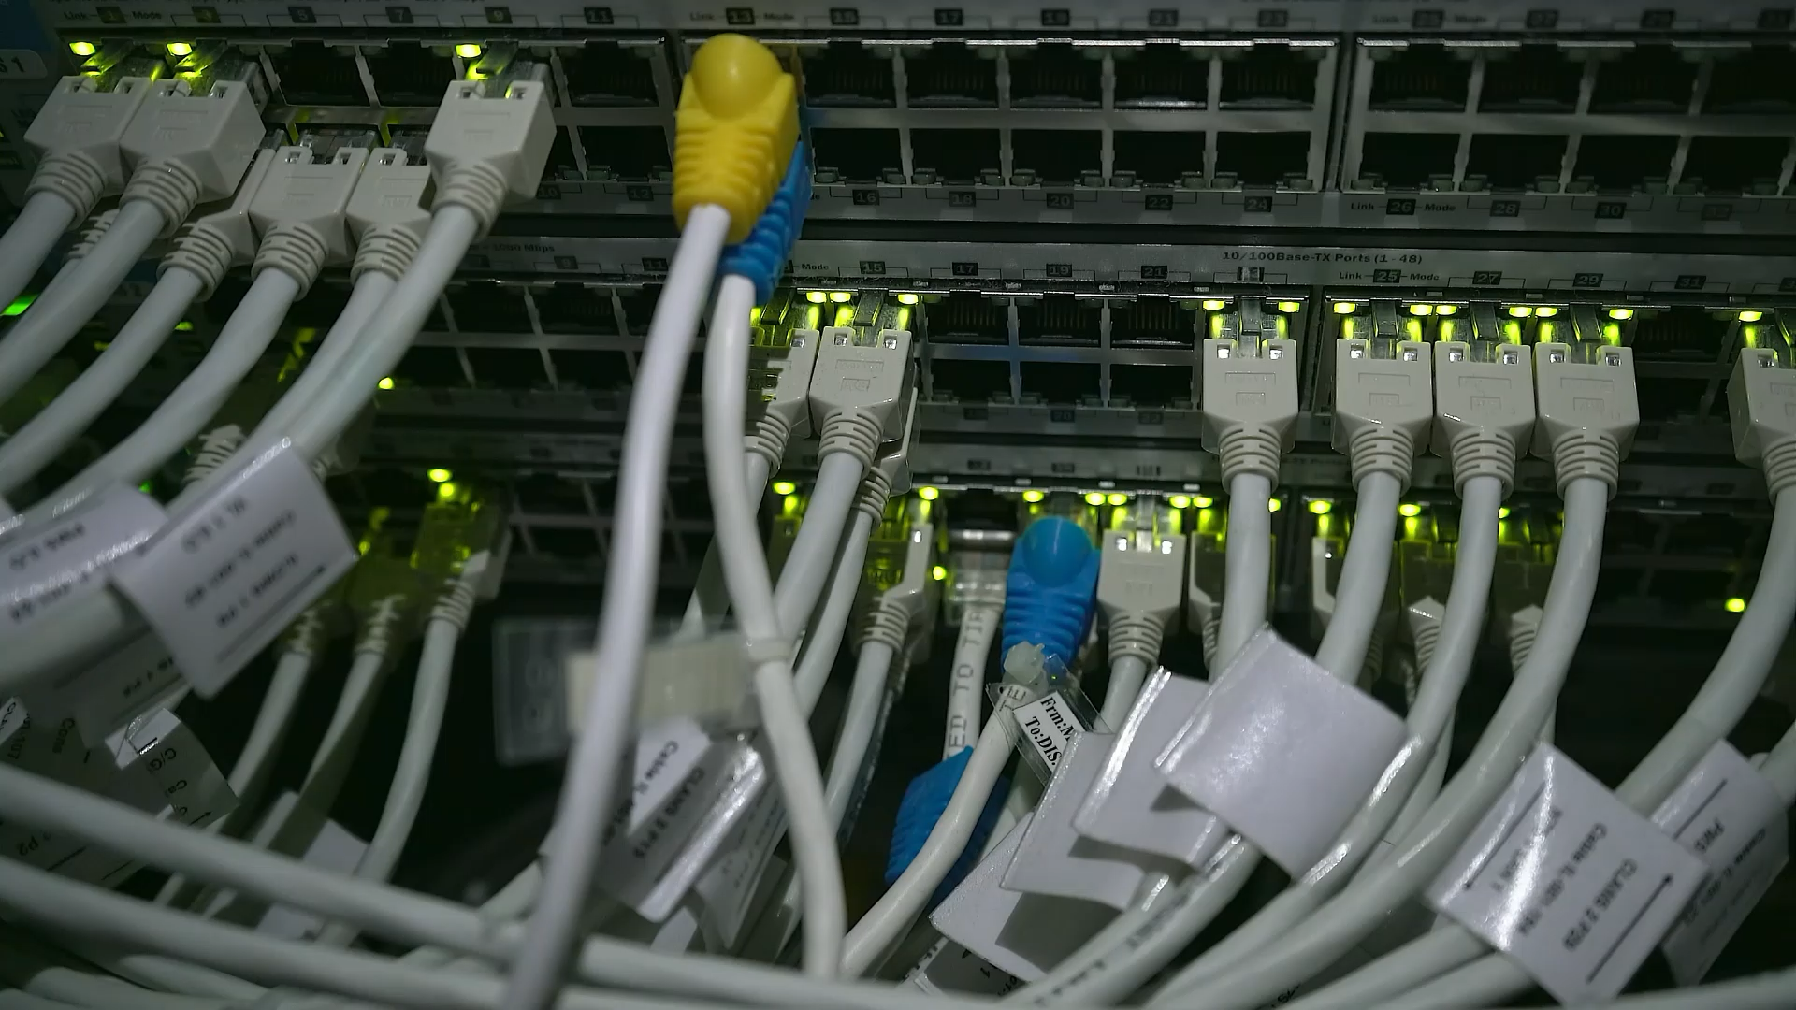
Hardware and software

Slide 2
Learning intentions and success criteria
Learning intention:
students will learn what hardware and software is and what their purpose is.
students will learn the suitability of hardware with particular performance characteristics against the needs of different users.
Success criteria:
I can explain what hardware and software is. I can see how sustainable it is. I am able to identify performance characteristics are needed for different users.

Slide 3
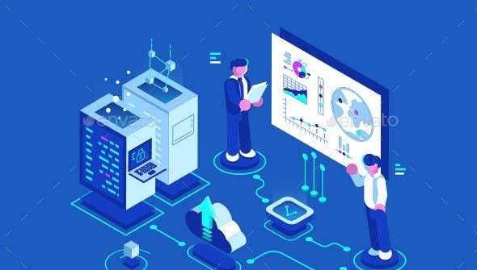

Class discussion
What do we think hardware and software is?
How is it used In our everyday life?

Slide 4
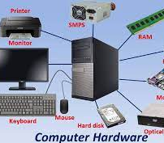
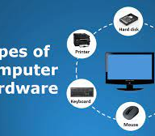
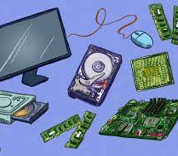

What is hardware?
Hardware is any physical component in a computer or electronic device.
There is 2 types of hardware, External and Internal.
Types of hardware includes: Central processing unit (CPU), Memory, motherboard, storage devices, input and output devices.

Slide 5




What is software?
Software refers to a collection of programs, data, and instructions that enable a computer or other digital devices to perform specific tasks or functions. Software can be narrowed down to 2 types.
Application Software: Application software is designed for specific tasks or functions that users want to perform.
system Software: This type of software is responsible for managing and controlling the hardware components of a computer, ensuring that they function together

Slide 6
What are some examples of application software?

Slide 7
What are some examples of system software?

Slide 8
How is software and hardware sustainable?
software
hardware
Energy efficient
Long lifespan and regular updates
Open sources and easy collaboration
Data efficient
Energy efficient
Materials and manufacturing uses recycled materials, energy consumption is also minimized during production
The product is made to have a longer lifespan
Products are made using an approach called “circular economy” this means the items can be recycled and reused over and over.

Slide 9

What is the difference between the software and hardware of the following?
Microsoft laptop
Gaming PC

Slide 10
What is the difference between the software and hardware of the following?
PlayStation
XBOX

Slide 11

Monday's lesson recap
What is hardware?
How many types of hardware is there?
What is software?
How many types of software is there?

Slide 12

Activity time!!
Open page 22 in our workbooks. We will do an example as a class and then each student will be assigned a different card to research.

Slide 13
Class discussion
What did we learn today?
Are we able to differentiate between hardware and software?
Can we differentiate between certain products that are needed for different uses.

